Slide 2
CONTENTS: 1.MOUNTAINS. 2.PLATEAUS . 3.PLAINS. 4.DESERTS 5.RIVERS. THE IMPORTANCES OF THESE LAND FORMS
4.MAJOR LANDFORMS

Slide 3
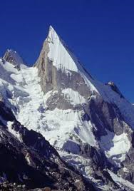
A LAND FORM WHICH RISES MORE THAN 900 M ABOVE THE SEA LEVEL. 20% OF TOTAL LAND AREA OF THE EARTH. DIFFER IN HEIGHT AND SHAPE. STEEP SLOPES. HIGHEST POINT OF A MOUNTAIN IS CALLED A PEAK OR A SUMMIT. MOUNTAIN PEAKS ARE CONICAL IN SHAPE.
THE MOUNTAINS

Slide 4
AGES OF MOUNTAINS
DEPEND ON HEIGHT AND SHAPE.
THE HIMALAYAS AND THE ALPS ARE YOUNG MOUNTAINS
THEY ARE HIGH AND CONICAL PEAKS.
THE ARAVALLIS AND THE APPALACHIAN ARE OLD MOUNTAINS.
THEY ARE LOW AND ROUNDED PEAKS.

Slide 5
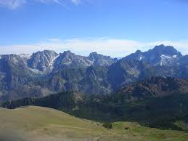
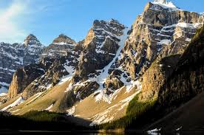
A CHAIN OF MOUNTAINS TOGETHER IS CALLED A RANGE.
RANGE
ANDES
ROCKIES
Chapter 4/social/karunambigai/Sns Academy

Slide 6
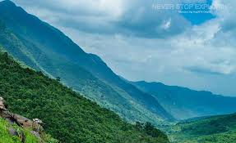
MOUNTAINS ACT AS A BARRIER AGAINST COLD AND HOT WINDS. RIVERS ORIGINATING FROM MOUNTAINS PROVIDE WATER FOR IRRIGATION. SLOPES OF MOUNTAINS HAVE RICH PASTURE LANDS AND VALUABLE FORESTS. MOUNTAINS ARE RICH IN MINERALS.
IMPORTANCE OF MOUNTAINS

Slide 7
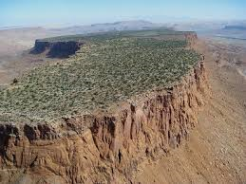
A HIGHLAND WITH FLAT TOP. STEEP SLOPES. MANY RIVERS AND STREAMS FLOW THROUGH PLATEAUS.
PLATEAUS

Slide 8
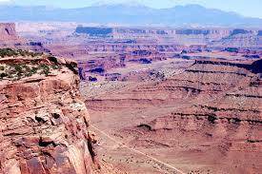
THE DECCAN PLATEAU –INDIA. THE TIBETAN PLATEAU –LARGEST AND HIGHEST PLATEAU IN THE WORLD. COLORADO PLATEAU –NORTH AMERICA. BOLIVIAN PLATEAU – SOUTH AMERICA.
EXAMPLES OF PLATEAU

Slide 9
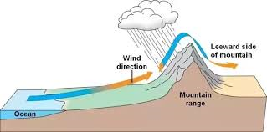
MOST PLATEAUS ARE IN DRY REGIONS AND ON THE LEEWARD SIDE OF THE MOUNTAINS

Slide 10
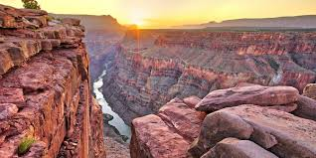
THE GRAND CANYON IN THE COLORADO PLATEEAU
CANYON
A canyon is a deep, narrow valley surrounded by tall cliffs. .

Slide 11
HAVE GRASSLANDS ON WHICH CATTLE AND SHEEP ARE REARED. PLATEAUS ARE RICH IN MINERAL DEPOSIT.
IMPORTANCE OF PLATEAUS

Slide 12
A FLAT AND LOW-LYING LAND SURFACE. ALSO CALLED LOWLANDS. FORMED BY THE DEPOSITION OF SAND AND SILT BY RIVERS. PLAINS ARE THICKLY POPULATED THAN MOUNTAINS AND PLATEAUS.
PLAINS

Slide 13
FERTILE SOIL-SUITABLE FOR AGRICULTURE. BIG CITIES AND TOWNS ARE LOCATED IN THE PLAINS. EASIER TO CONSTRUCT ROADS,RAILWAYS,AERODROMES AND CANALS.
IMPORTANCE OF PLAINS

Slide 14
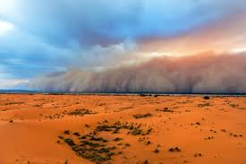
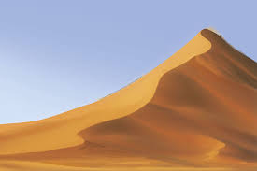
HOT DAYS AND COLD NIGHTS. FREQUENT DUST STORMS. HILLS OF SAND CALLED SAND DUNES. LITTLE VEGETATION.
DESERTS
LAND AREAS RECEIVE LITTLE OR NO RAINFALL.

Slide 15
SAHARA AND KALAHARI DESERT- AFRICA THE GREAT SANDY DESERT AND THE GREAT VICTORIA DESERT- AUSTRALIA THE THAR DESERT AND THE ARABIAN DESERT – ASIA THE ATACAMA DESERT AND PATAGONIAN DESERT – SOUTH AMERICA
EXAMPLES OF DESERTS

Slide 16
MOUTH OF A RIVER The place where a river enters a lake, larger river, or the ocean is called its mouth.
RIVERS
A river is a natural flowing watercourse, usually freshwater, flowing towards an ocean, sea, lake or another river.
Rapids
Part of a river where the water moves very fast, often over rocks..

Slide 17
1.THE UPPER COURSE OR YOUNG COURSE 2.THE MIDDLE COURSE OR MATURE COURSE 3.THE LOWER OR THE OLD COURSE
3 DIFFERENT COURSES OF RIVER

Slide 18
ORIGINATE IN THE MOUNTAINS. THE SPEED OF THE RIVER IS HIGH. CUTS A DEEP AND NARROW CHANNEL IN THE MOUNTAINS. FEATURES OF UPPER COURSE ARE CANYONS,WATERFALLS AND RAPIDS.
THE UPPER COURSE

Slide 19
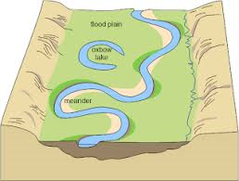
BEGINS WHEN IT LEAVES THE MOUNTAINS AND ENTER THE PLAINS. VALLEY WIDENS. SPEED OF THE WATER DECREASES AND THE RIVER DEVELOPS LOOPS ,WHICH ARE CALLED MEANDERS.(A meander is a winding curve or bend in a river.)
THE MIDDLE COURSE OR THE MATURE COURSE

Slide 20
THE RIVER JOINS BIGGER WATER BODY SUCH AS SEA. THE SPEED OF THE RIVER IS VERY SLOW. THE RIVER DEPOSITS THE SILT ,IT CARRIES NEAR THE MOUTH,FORMING A TRIANGULAR SHAPED LAND CALLED DELTA. THE LARGEST DELTA IN THE WORLD IS FORMED BY GANGA AND THE BRAHMAPUTRA RIVER BEFORE JOINING THE BAY OF BENGAL IS SUNDERBAN DELTA.
THE LOWER COURSE OR THE OLD COURSE

